Slide 1

Algorithm Compendium DISSERTATION THESIS July, 2016
Author: Fermuș V. Vasile-Octavian
Coordinator: Asist. Dr. Vasile Alaiba

Slide 2
Contents
Introduction
Used technologies
Application pages
Improvement ideas
Conclusions
Special thanks

Slide 3
1. Introduction
This application is an online platform that attempts to be a
“teach and learn” environment for programmers and students in the field of IT.
Among other things, users are allowed to:
Request and post algorithms
Discuss certain lines of code regarding posted algorithms
Talk privately or join conversational groups

Slide 4
2. Used technologies
Front-End Languages
HTML5 – Page layouts
SCSS (with CSS3) – Page stylization
JavaScript – DOM manipulation and page scripting
Front-End Libraries and Frameworks
jQuery – Ajax requests and improved functionalities
jQuery-UI – Certain UI elements such as draggables
Ace Editor – Creating the algorithm visualization and manipulation
Bootstrap – Advanced CSS grid functions

Slide 5
2. Used technologies
Back-End Programming Languages
PHP
MySQL
Back-End Libraries and Frameworks
Laravel 4.2 – Session control, advanced database manipulation, templating, APIs
Other
Grunt – Automation and SCSS compilation
GitExtensions and GitHub – repository hosting and revision control

Slide 6
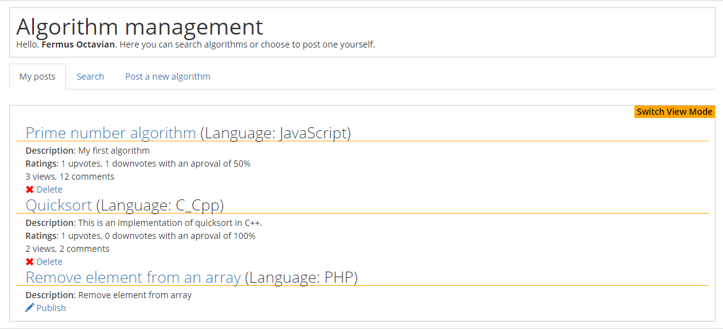
3. Application pages Home page – My posts
Home page – My posts tab

Slide 7
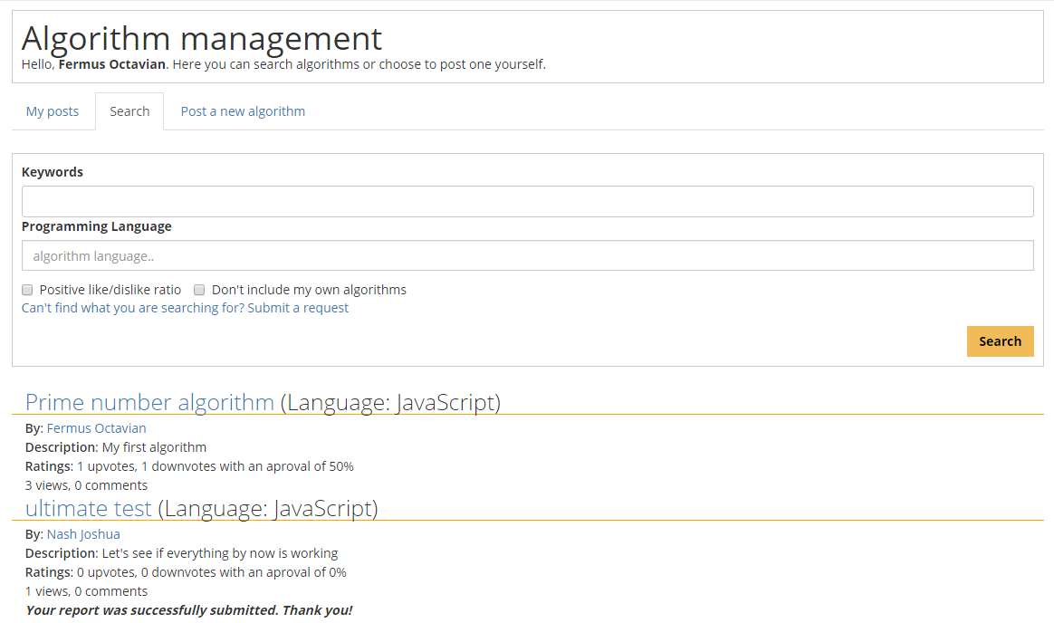
3. Application pages Home page – Search
Home page – Search tab

Slide 8
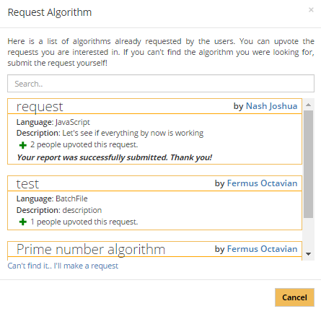
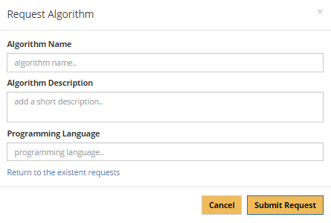
3. Application pages Home page – Submit request
Home page – Request algorithm list
Home page – Request algorithm form

Slide 9
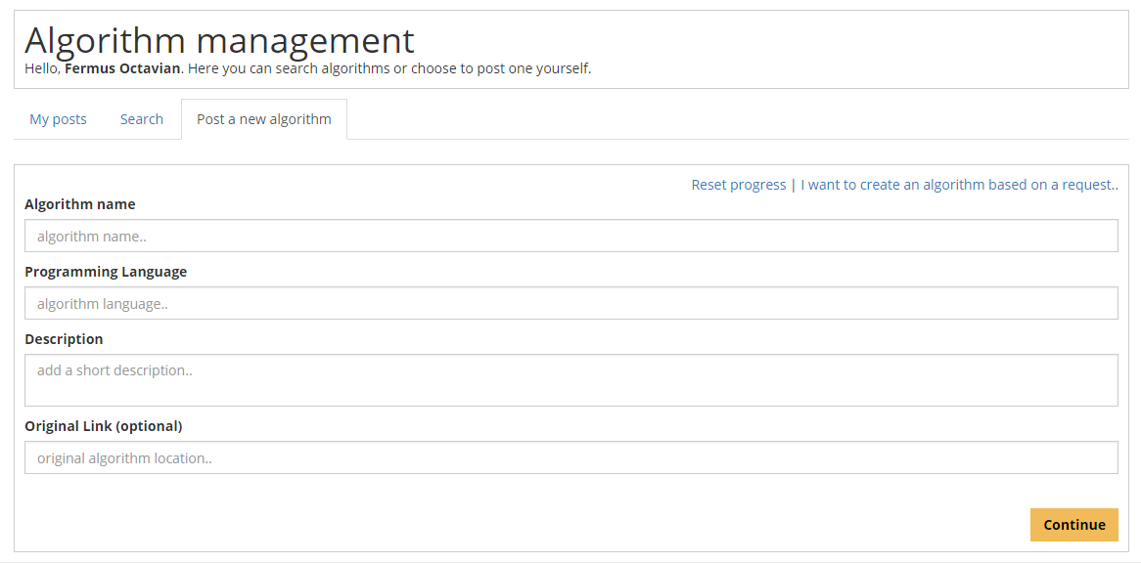
3. Application pages Algorithm post process – Part I
Snippet of the first part of the post process

Slide 10
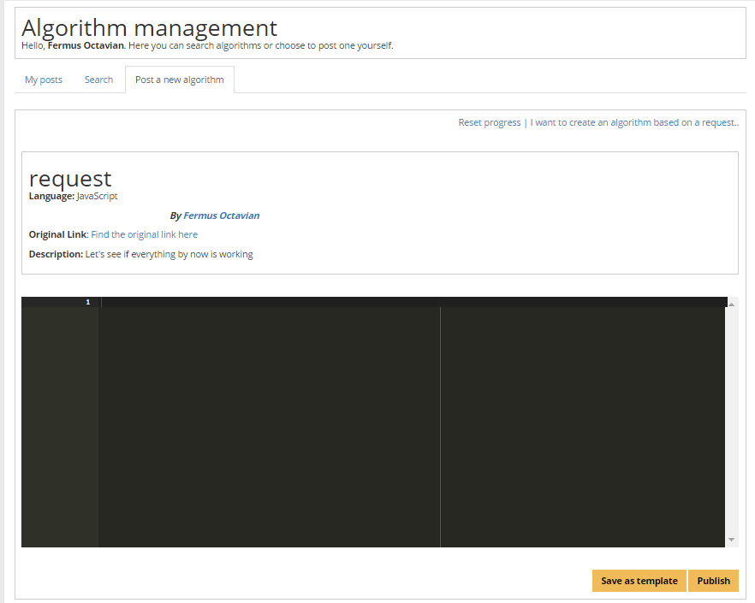
3. Application pages Algorithm post process – Part II
Algorithm post process page snippet, after entering the page details

Slide 11
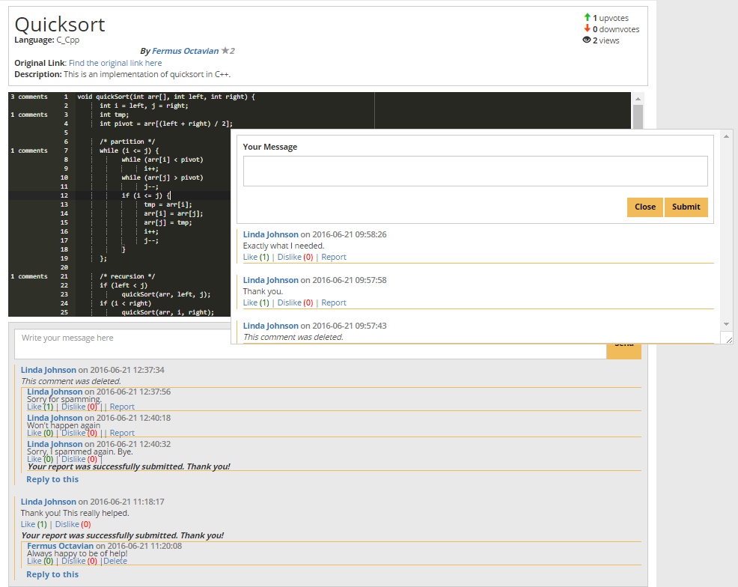
3. Application pages Algorithm post page
Main post page snippet

Slide 12
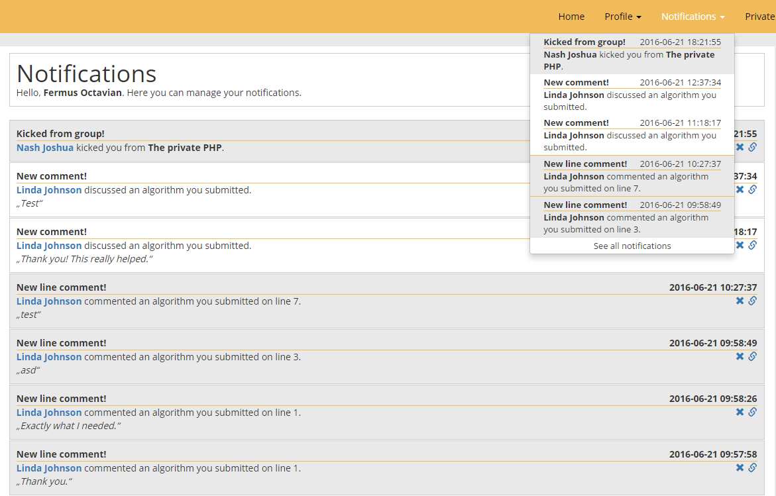
3. Application pages Notifications page
Notifications page snippet

Slide 13
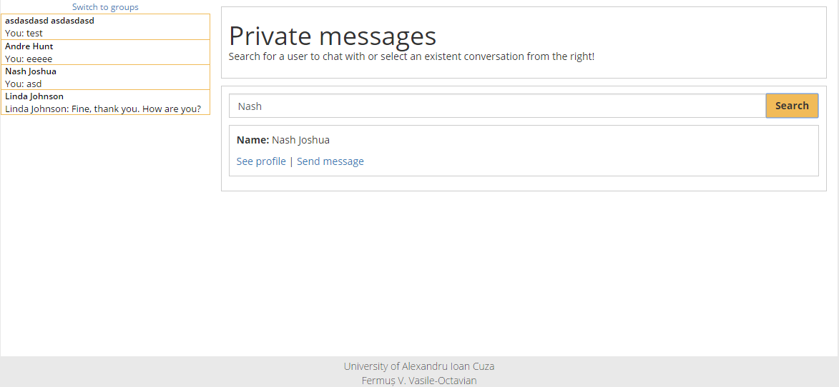
3. Application pages Messaging pages Part I
Private messaging main page example

Slide 14
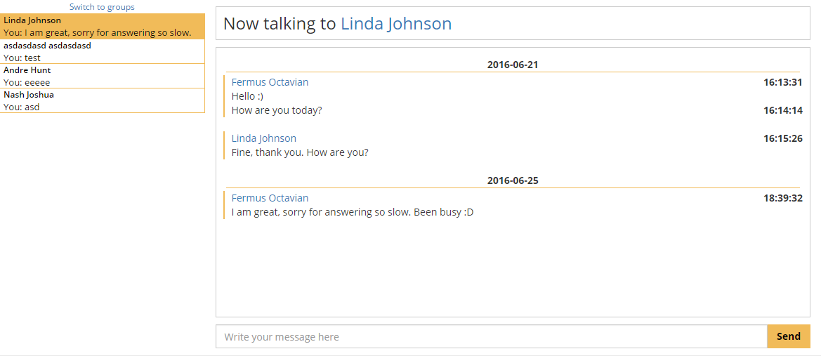
3. Application pages Private messaging part II
An example of a private conversation between two users

Slide 15
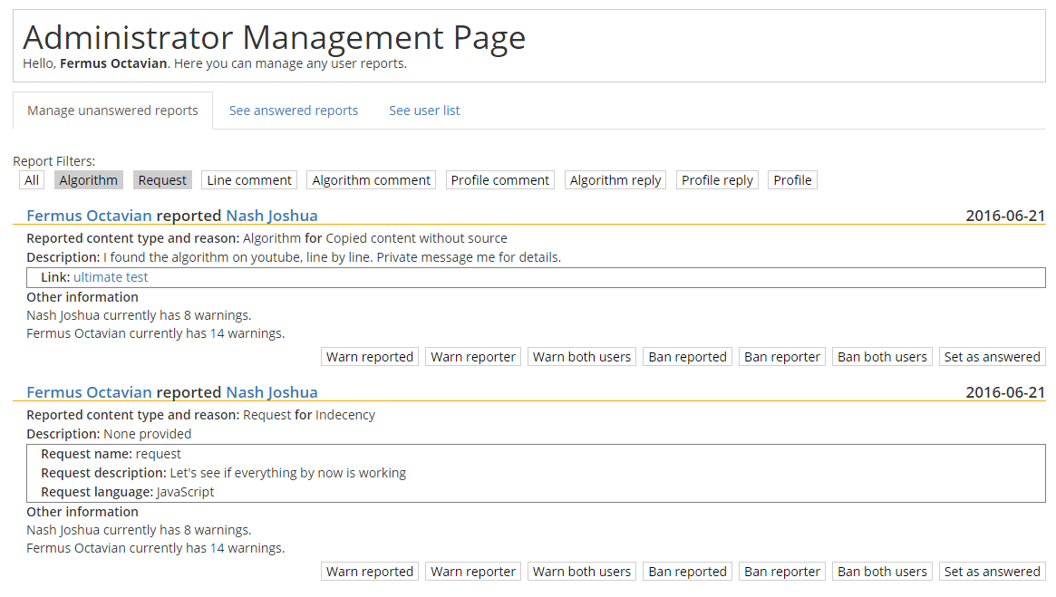
3. Application pages Administrator page - Reports
Snippet example of a report page

Slide 16
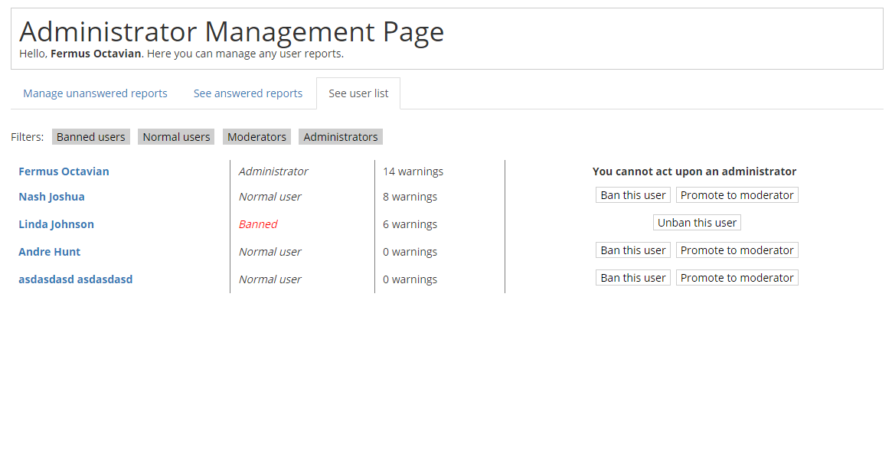
3. Application pages Administrator page – User list
Snippet example of a report page

Slide 17
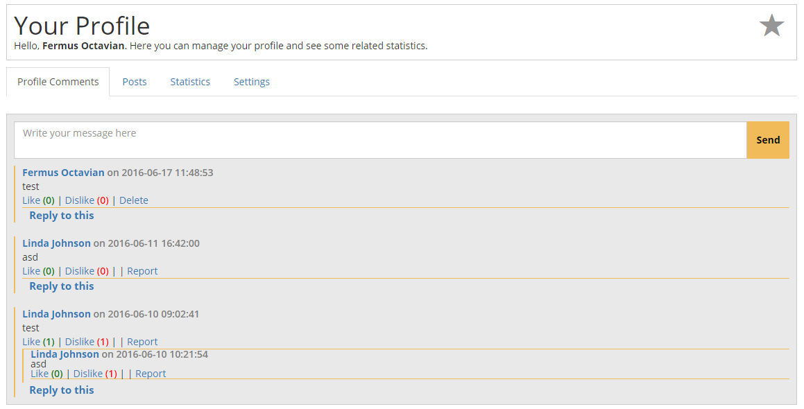
3. Application pages Profile page
Snippet example of a profile’s main page

Slide 18
Improvement ideas
Introducing Node.js for the website for real-time notifications, messaging and general responsiveness
Improving the commendation process for active users
Creating a viable mobile version of the application (regarding the algorithm viewing and commenting, especially)
Replacing the Ace Editor JavaScript library with a more specialized, self made library tailored for the application

Slide 19
Conclusions
The created platform is a viable alternative to other learning websites.
The community is encouraged to interact and help each other.
The extensive use of APIs instead of conventional forms help speeding up the application navigation and use.
I heavily improved my understanding of Back-End development and the Laravel framework.

Slide 20
Special Thanks
I would like to thank:
Dr. Asist. Vasile Alaiba for his invaluable help and coordination
Professor Sabin-Corneliu Buraga for his Web related classes

Slide 21
QUESTIONS?

Slide 22
Thank you for your time

